Slide 1
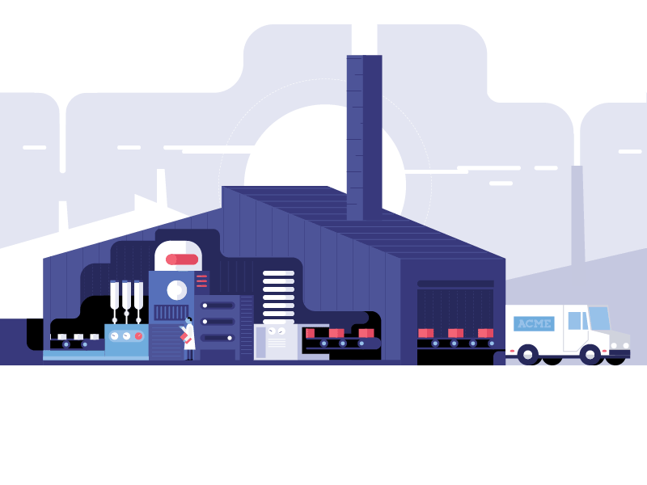
NHÓM 1:
FACTORY METHOD

Slide 2







PROBLEM
ADVANTAGE AND DISADVANTAGE
STRUCTURE
APPLICATION
HOW TO IMPLEMENT
RELATIONS WITH ANOTHER PATTERNS

Slide 3
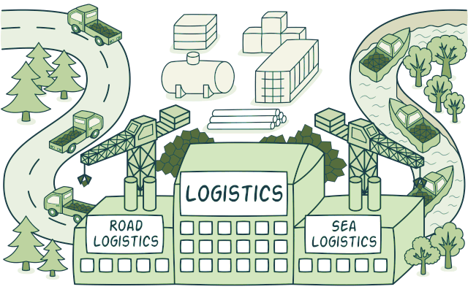
PROBLEM

Slide 4
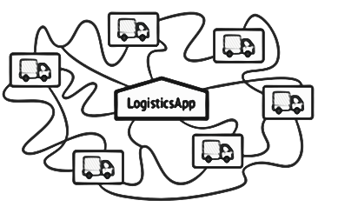
Logistics Transportation Management
The first version of app only handle transportation by trucks
→ major codes are inside the Truck class

Slide 5
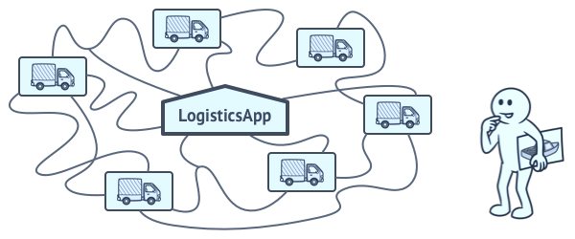

Question is?
IF WE WANT TO EXPAND OUR LOGISTICS MANAGEMENT TRANSPORTATION, WHAT WILL HAPPEN?

Slide 6

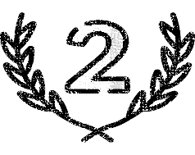
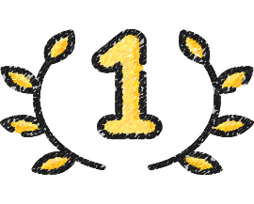

Slide 7
After adding new means of transport
Making changes to the entire codebase
Adding a new class to the program isn’t simple if the rest of the code is already coupled to existing classes

Slide 8


Slide 9




Move the constructor call from one part of the program to another
The object sill create via the new called within the factory method
Replace diret object construction
(new operator)
Objects returned by a factory as “products”

Slide 10
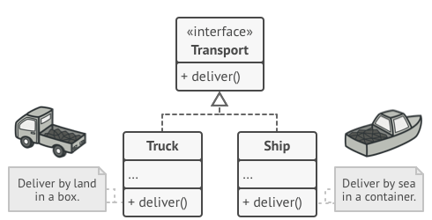
Truck and Ship classes should implement the Transportation interface declares a method called deliver
The RoadLogistics class returns Truck objects, The SeaLogistics class returns ship

Slide 11



A creational design pattern
Provides an interface for creating objects in a superclass
WHAT IS FACTORY METHOD?
Allows subclasses to alter the type of objects that will be created

Slide 12
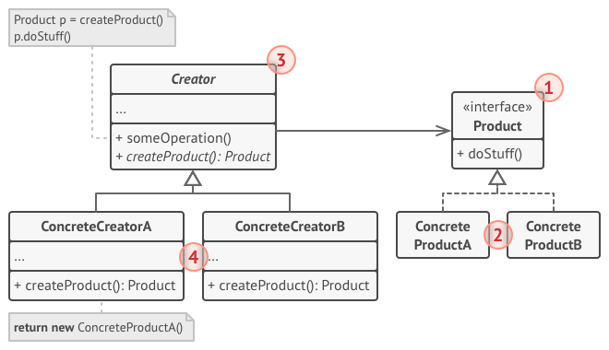
Declares the factory method that returns new product objects. It’s important that the return type of this method matches the product interface
declares the interface common to all objects that can be produced by the creator and its subclasses.
STRUCTURE
are different implementations of the product interface
Override the base factory method → it returns a different type of product

Slide 13

base factory method has become empty, you can make it abstract
Reuse the control parameter from the base class in subclasses
HOW TO IMPLEMENT?
Create a set of creator subclasses for each type of product listed in the factory method
Replace references with calls to the factory method
Add an empty factory method inside the creator class
Make all products follow the same interface

Slide 14
enum LogisticsType
{
Road, Sea
};
class LogisticsManagement
{
public:
LogisticsManagement() { }
virtual void deliver() = 0;
virtual void printVehicle() = 0;
static LogisticsManagement* Creation(LogisticsType type);
};

Slide 15
class onRoad : public LogisticsManagement
{
public:
onRoad() { }
void printVehicle(){
cout << "This is a truck" << endl;
}
void deliver() { }
~onRoad() { }
};
class onSea : public LogisticsManagement
{
public:
onSea() { }
void printVehicle(){
cout << "This is a ship" << endl;
}
void deliver() { }
~onSea() { }
};

Slide 16
LogisticsManagement* LogisticsManagement::Creation(LogisticsType type)
{
if (type == Road)
return new onRoad();
else if (type == Sea)
return new onSea();
else return NULL;
}

Slide 17
class Client
{
//Clients don't explicity create object but passes type to factory method Creation()
public:
Client()
{
LogisticsType type = Road;
logisticsVehicle = LogisticsManagement::Creation(type);
}
~Client()
{
if (logisticsVehicle)
delete[] logisticsVehicle;
logisticsVehicle = NULL;
}
LogisticsManagement* getVehicle()
{
return logisticsVehicle;
}
private:
LogisticsManagement *logisticsVehicle;
};

Slide 18


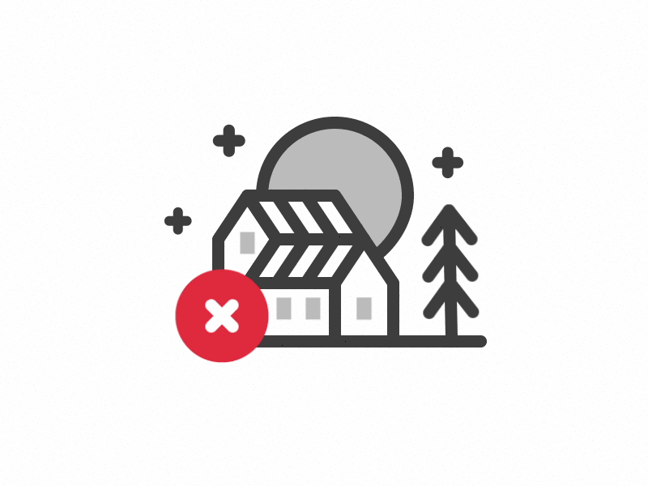
Loose coupling helps in changing the appicaton design more readily
Reduced readability due to increased abstraction
The application is seperated from a family of classes
Advantage
Disadvantage
It makes the application more customizable
Applicable only for families of classes

Slide 19




When you want to prodivde users of your library or framework with a way to extend its internal componenets
When you don’t know beforehand the exact types and dependencies of the objects your code should work with
When you want to save system resources by reusing existing objects instead of rebuilding them each time

Slide 20




Abstract Factory
Propotype
FACTORY METHOD
Template Method
Iterator

Slide 21
CẢM ƠN
THẦY VÀ CÁC BẠN
ĐÃ LẮNG NGHE

